Slide 1

Administrator Debrief Presentation
Sara Bruns
1.23.23

Slide 2
Table of Contents
Your Account Structure
Business Account Navigation
    Individual/Shared Settings
    Business Order Information
    Delivery Preferences
    Business Lists
Members
    User List Download
    Buying Policies
      Your Buying Policies
      Approvals
Amazon Business Analytics & Spend Visibility
Your Orders / Customer Support
Supplemental Documentation
Notes:
Topics Discussed, Contents, Table of Contents, Areas of Focus

Slide 3

Your Account Structure:
35 Legal Entities/Schools
Rowan Salisbury Schools
Account Notes:
Payments: PBI (Shared)
Shipping: (Shared)
Legal Entities Structure: Divided by School

Slide 4
Business Account Navigation
Support Videos [CLICK HERE]
Group management video (including shared/individual settings)

Slide 5
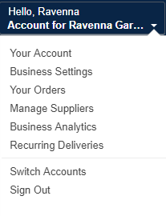
Business Account Navigation
Page | Functionality
Your Account | Standard Amazon account information
Business Settings | Business Management pages. Add users, set up groups, configure buying policies, etc.
Approve Orders | If workflow approvals are enabled, approvers can view and take action on pending orders
Your Orders | View and track your orders. Administrations can view orders others have placed on behalf of the organization
Manage Suppliers | Easily find suppliers on Amazon Business and add them to your list of Saved Suppliers. Learn more.
Business Analytics | Create and filter custom reports based on your business needs to view your organization’s orders
Recurring Deliveries | Have essential items delivered automatically, based on a schedule you choose. Learn More.

Slide 6
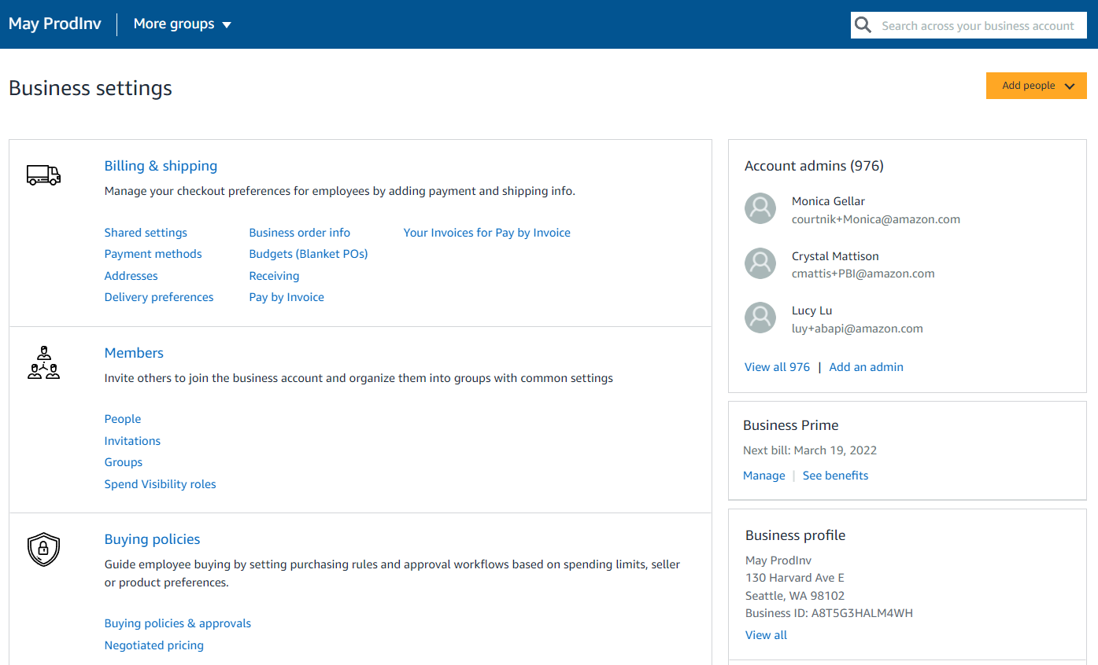
Business Settings
Amazon Business Administrators have the ability to add and remove users, update payment methods, create or edit order & buying policies, and more within the “Business Settings” page.

Slide 7
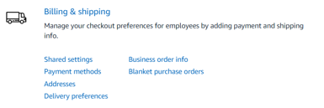
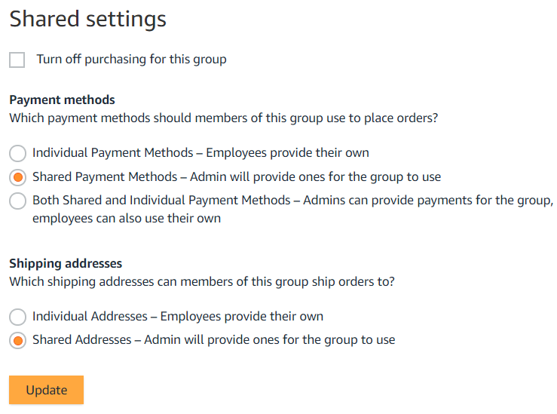
Individual/Shared Payment & Shipping Settings
Administrators can configure at the group level whether Payment Methods and Shipping Addresses will be shared and managed by an Administrator or Individual and managed by the end user.
Considerations
Individual:
End users enter and store addresses during initial setup or checkout
Administrators use analytics reports to audit shipping locations
Shared:
  Administrators enter addresses for each group manually or with an upload spreadsheet
  End users can only ship to addresses shared with their group by an Administrator
  End users will have an option to add their name in the “deliver to” field
Shared and Individual (Payment Only):
Administrators can provide payment and end users can also use their own in the same group
Note: Shared settings will default to Both Shared & Individual for Payment Methods and Individual Addresses. Ensure you configure Shared Settings for any newly created group(s).

Slide 8
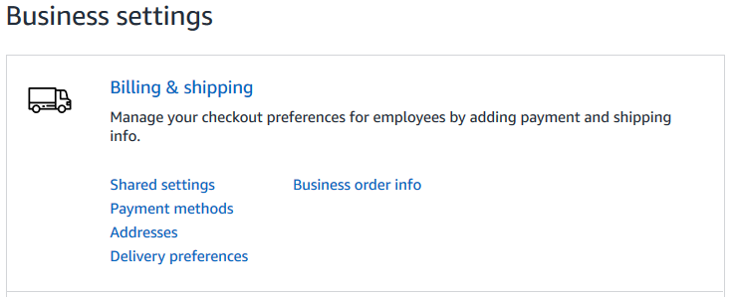
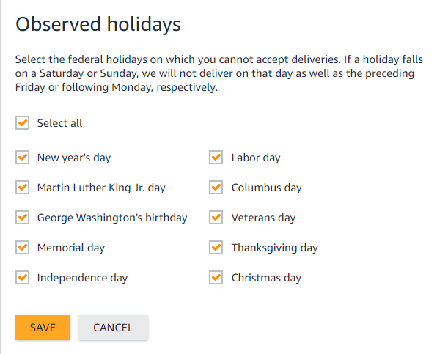
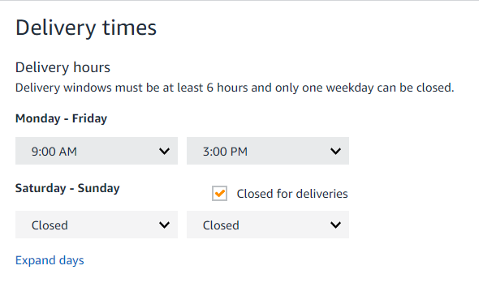
Delivery Preferences
Customize delivery days and times to ensure your packages are delivered when someone is available to receive them
Settings can be adjusted under Business Settings>Billing & delivery preferences by root level admins
Preferences entered here will be the default for all shipping addresses on the account, however they can be adjusted by address as needed
Changes made here will only impact items shipped from Amazon
If shared settings these will store to the address for all users
If individual settings each user will configure this for their own use

Slide 9
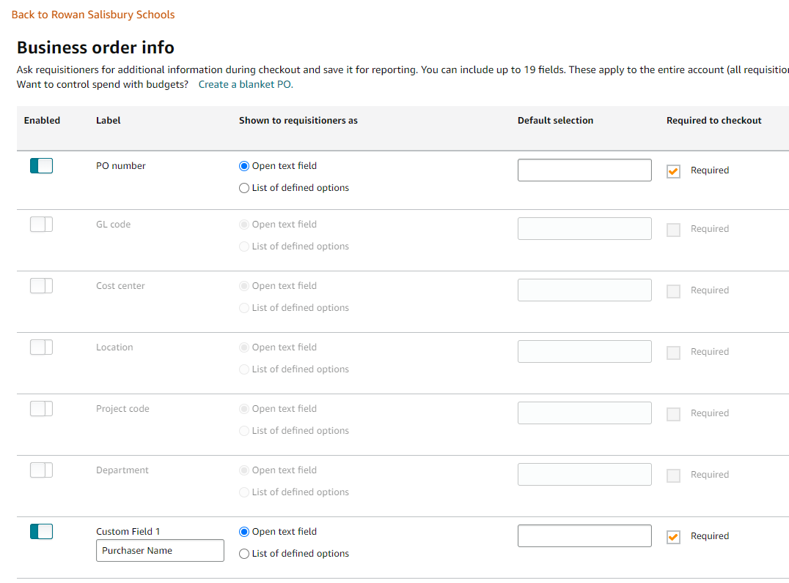
Business Order Information
Track and manage orders by setting up custom fields that display on order documentation and reports
Business Order Information needs to be activated at the account level by an account Admin.
All information entered will appear in Order History Reports in the Business Analytics tool.
Each field can be required or optional.
There are up to 100 options that can be pre-configured in a drop down style menu.
Available Fields
GL Code | Cost Center
Project Code | Location
Department | *Custom named field*
Purchase Order (PO)

Slide 10
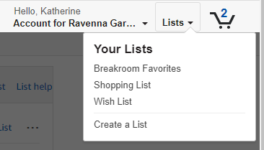
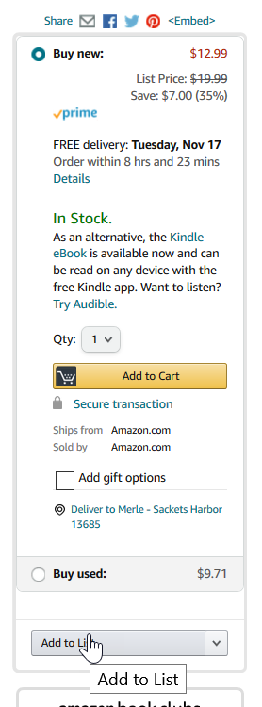
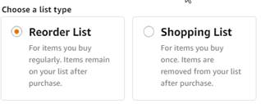
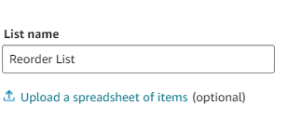
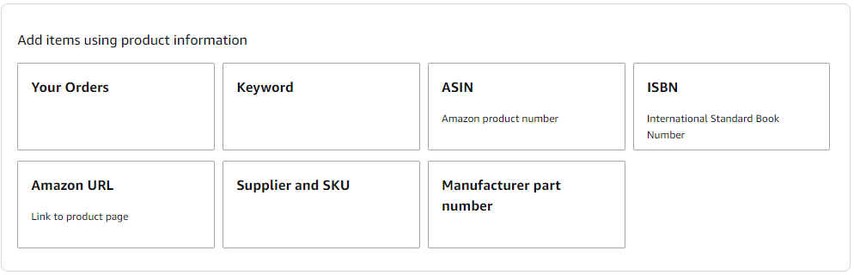
Business Lists – Creating Lists
How do lists work on Amazon Business?
Lists make it easy to keep track of the things you need and are easy to share with others. Any User on Amazon Business can create a shopping list
See Create a List (link) for a detailed 1-pager on how to create list for future reference
Simply hover over Lists in the top right corner of the main page and click “Create a List”
Select re-order so items remain on list for future purchases
Easily upload multiple items via spreadsheet template or search/browse by key words such as ASIN, keyword, part #, and even your past orders

Slide 11
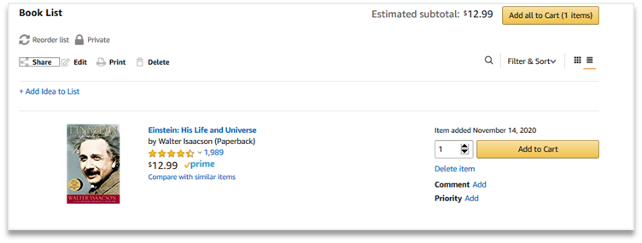
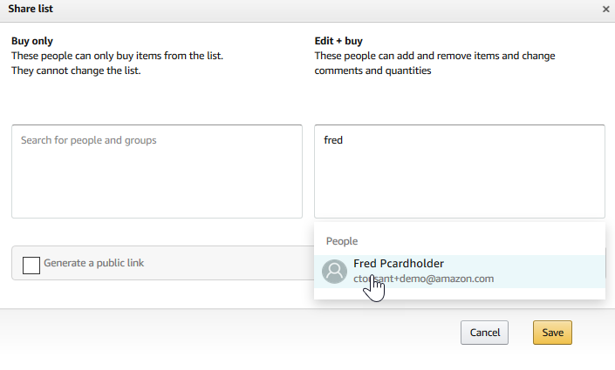
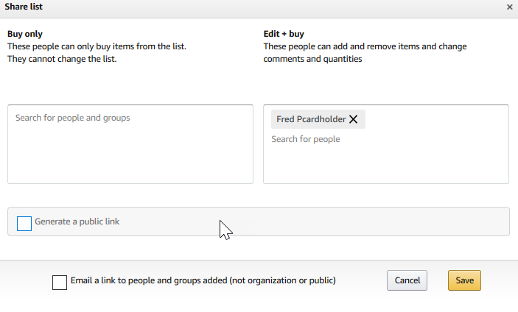
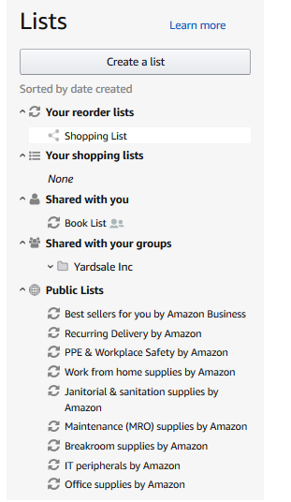
Business Lists – Sharing Lists
Sharing the list
Click “Share” to choose a user with whom you would like to share the list.
Choose whether the user will be able to edit the list and enter then enter a name in the box underneath.
Once you select the name, choose whether you want the user to receive an email notifying the user a list has been shared.
Click save and now the list appears in the selected user’s Shared with you within Lists.
Link to 1-pager on how to share/review lists:
Sharing a List
Reviewing a Shared Shopping List

Slide 12
Members
Support Videos [CLICK HERE]
User roles/Permissions video
Group management video
Adding/Removing Users video

Slide 13
User Roles & Permissions
Each user can have multiple roles -- administrator or requisitioner, or both. Permissions can be assigned when an administrator invites a user to the business. Administrators can change user permissions at any time.
Assign administrator permissions on a per-group basis. One administrator can manage multiple groups. Group level administrators only have admin authority over the group(s) they are assigned.
Role | Permissions & Functionality | Visibility
Admin | Manage business settings & business features Invite people to join the business account Remove users from the business account Assign a role to a user Set up approval workflows and spending limits Configure shared payment methods and shipping addresses Add certifications such as tax exemptions to the business account | Administrators can view orders and order history for all purchases in their group(s) on behalf of the business. Last 4 digits of any payment methods used by Requisitioners Billing & Ship to addresses All Amazon Business Analytics fields for orders placed by users in their group(s)
Buyer (requisitioner) | Place orders on behalf of the organization Add payment methods and shipping addresses at checkout *if individual pay is configured Utilize Business Analytics for their own purchases Can be configured as an Approver | Order history for all orders that they placed for their organization with their business user account Shipping addresses & payment methods (last 4 digits visible), as established by the administrator
PunchOut User | Place orders on behalf of the organization through a punchout session Add payment methods and shipping addresses at checkout *if individual pay is configured Utilize Business Analytics for their own purchases | Order history for all orders that they placed for their organization with their business user account Shipping addresses & payment methods (last 4 digits visible), as established by the administrator
Finance | Access invoices, credit notes, analytics, and order history. Access, customize, and schedule Amazon Business reports, and manage tax information.
Tech | Manage domain names, authentication methods, API keys, and IT system integrations such as purchasing systems, transaction data, and single sign-on.

Slide 14
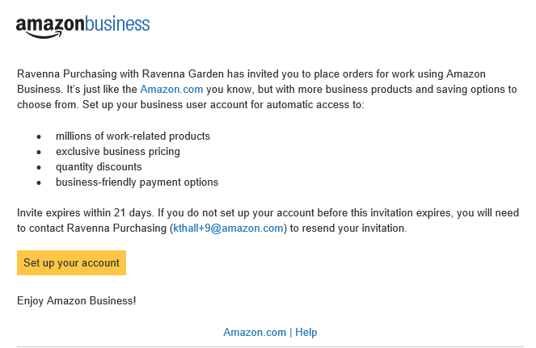
Inviting Users to Amazon Business
Administrators can add users to the account one by one or all at once by uploading a spreadsheet
How do Invitations Work?
When a user is added to the business account, an invitation to join is immediately emailed.
Invitations are tied to an end users email address. The recipient cannot change the email address they use to register for the account.
End users must take action after being invited to an account in order to become an active user.
User permissions are assigned when a user is invited.
Account invitations are valid for 90 days from send date. After 90 days, they will expire and need to be resent
your account admin email@company.com)

Slide 15
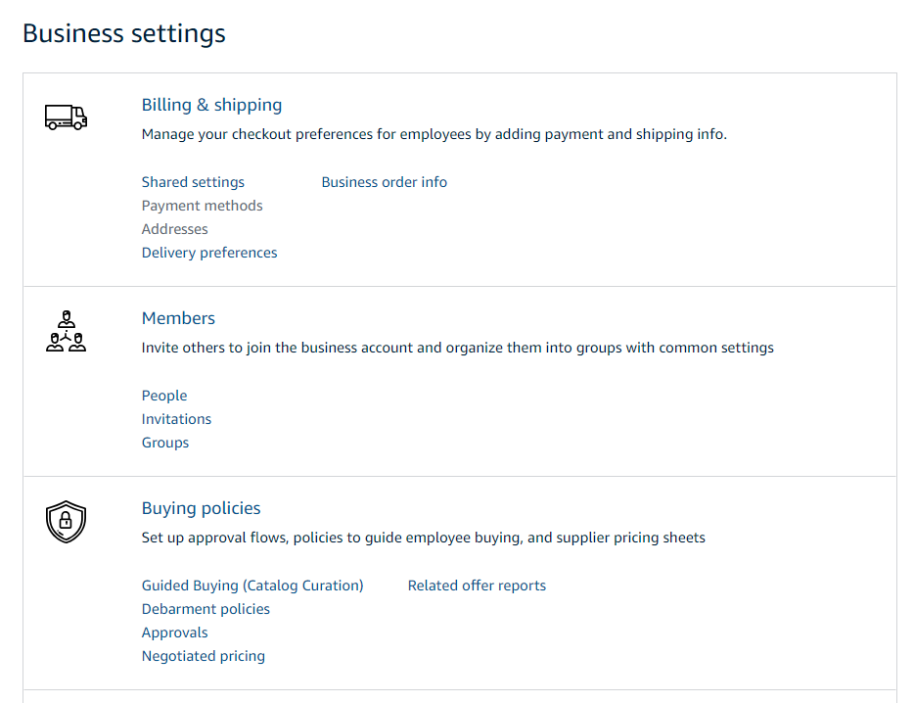
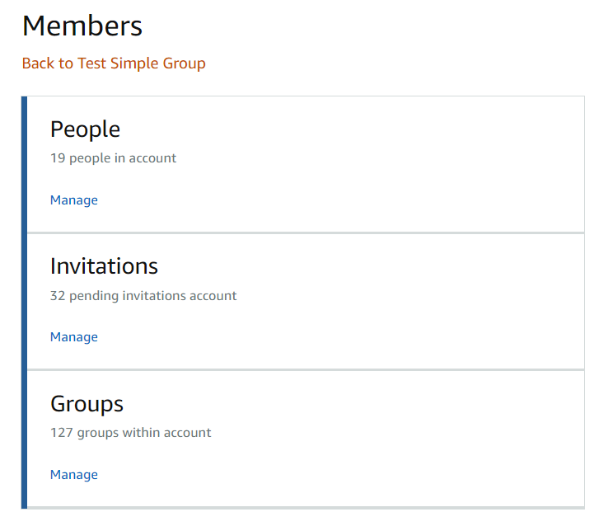
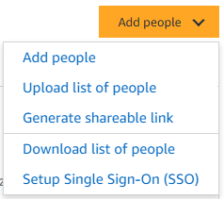
Members
Invite others to join the business account and organize them into groups with common settings
The People section of your account enables you to manage all active users on the business account. You can add and remove users, edit user roles, and download a complete list of account users from this section of your account.
The Invitations section tracks all pending and expired invitations to users. Once a user has accepted their invitation, that person will move to the People section.
To help keep your users organized, people can be added to specific Groups. Many settings such as approvals, shared payment methods, and catalog curation messages can be configured at the group level

Slide 16
Download List of Users and Pending Invitations
Invitation Status | Definition
“Expired” | The invitation has expired and an administrator must re-send a new invitation for the user to join (see this slide)
“Pending” | User is a member of an existing consumer account, and they must take action via the link sent to them in an invitation. The user will be required to “Convert” their account or “Split” personal account history (see FAQ)
“Pending Merge”** | User is a part of an existing business account, and they must take action via the link sent to them. This process will de-register their existing Business Account and allow them to merge into the official business account, maintaining purchase history.
“Merge Deferred”** | User has indicated they do not want to merge their existing business account into the official account.
Blank (the cell is empty) | The user is ACTIVE and a member of the indicated group(s). For automatically created accounts, the user may not have set their password yet. In this case, the user must follow password reset instructions (see FAQ).
Invitation URL can be sent directly to invitee to activate their login

Slide 17
Buying Policies
Support Videos [CLICK HERE]
Guided buying Overview video
Configure guided buying video
Configure spend limits / approval workflow video
Reviewing approval requests/process video

Slide 18

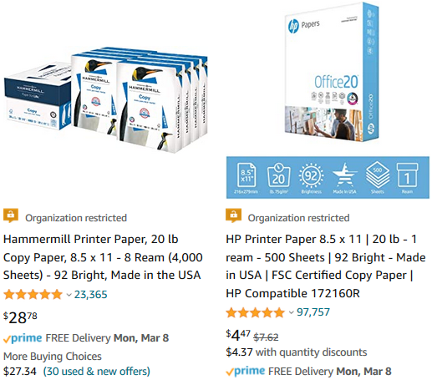
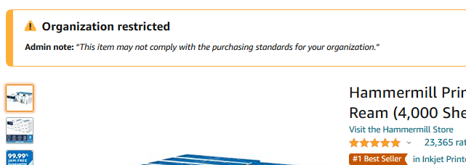
Rowan Salisbury Schools Restricted Policies
Administrators can customize messaging to let end users know IF and WHEN they can purchase certain UNSPSC based categories on Amazon Business
Restricted products will be clearly marked throughout the buying process
Purchases with Restricted items may require additional approval
Administrators have direct visibility into any restricted purchases via Business Analytics
Notes:
--Remove if GB not in scope--

Slide 19
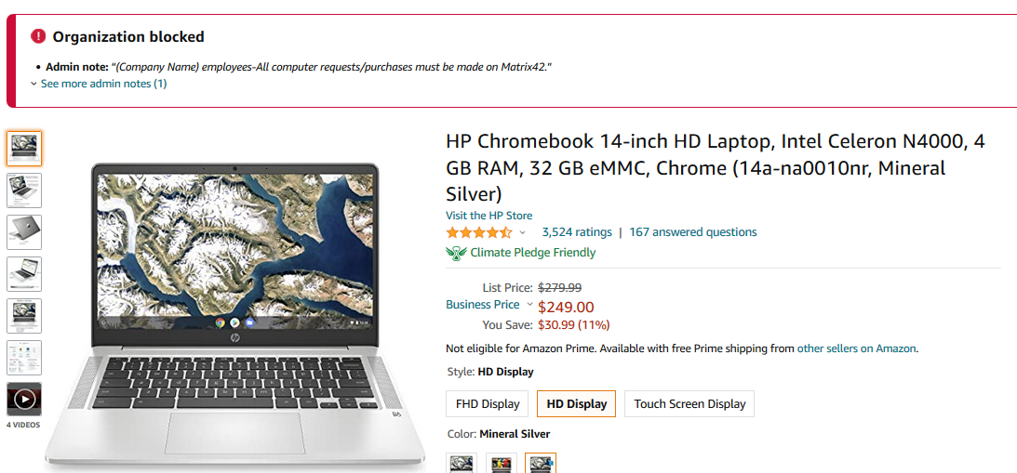
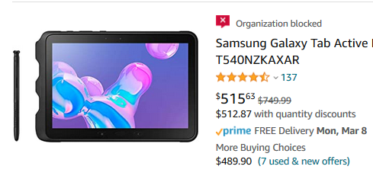
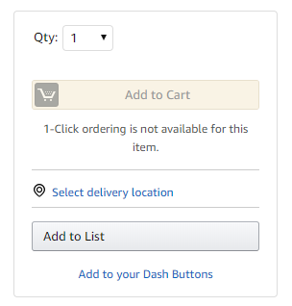
Rowan Salisbury Schools Blocked Policies
Hard blocking product categories prevents an end user from adding these product to their cart. The add to cart option will appear greyed out for any product categories that are blocked
Please contact IT for laptop acquisition.
Notes:
--Remove if GB not in scope--

Slide 20

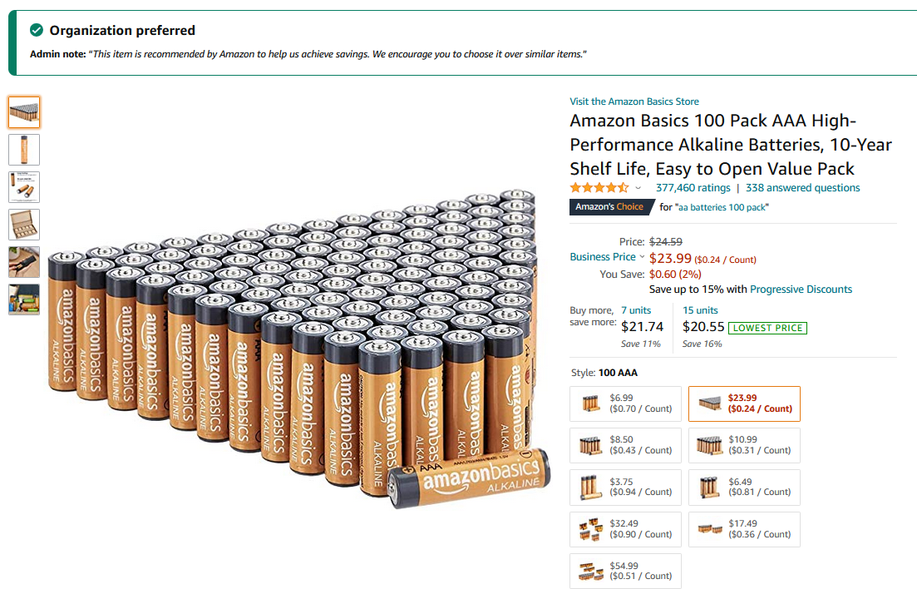
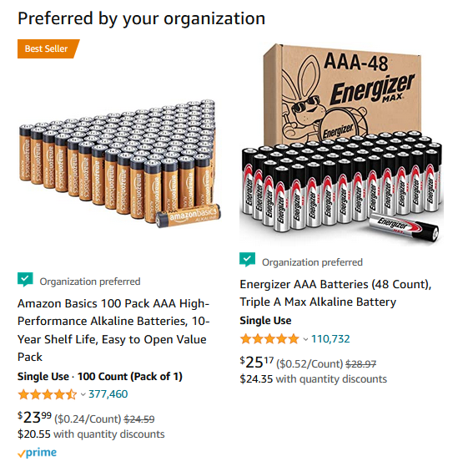
Rowan Salisbury Schools Preferred Products/Sellers
Mark specific products as preferred to ensure your end users can easily find what they are looking for. This messaging is visible throughout the shopping experience, search results, and on product detail pages.
Notes:
--Remove if GB not in scope--

Slide 21
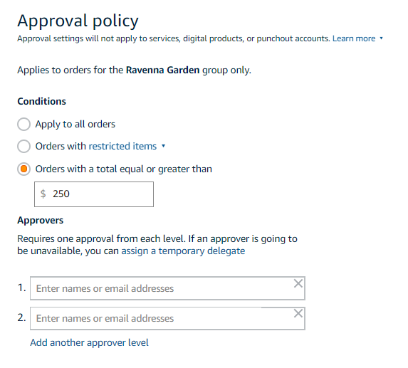
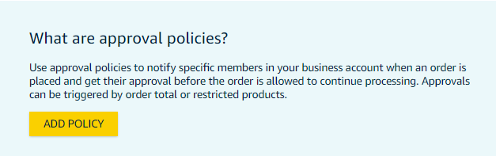
Approvals
Approval workflows provide visibility and control over purchasing
Administrators can configure up to 6 levels of approvals. Each level of approval can have more than one approver. Only one approval is needed at each level.
Approvers are notified of pending orders through email as well as when they log into their Amazon Business account.
Requisitioners or Administrators can be designated as approvers.
Only active account users can be configured as approvers.
Approvals can be set up at individual group levels by navigating to Buying policies > Approvals and then further customized for individual users.

Slide 22
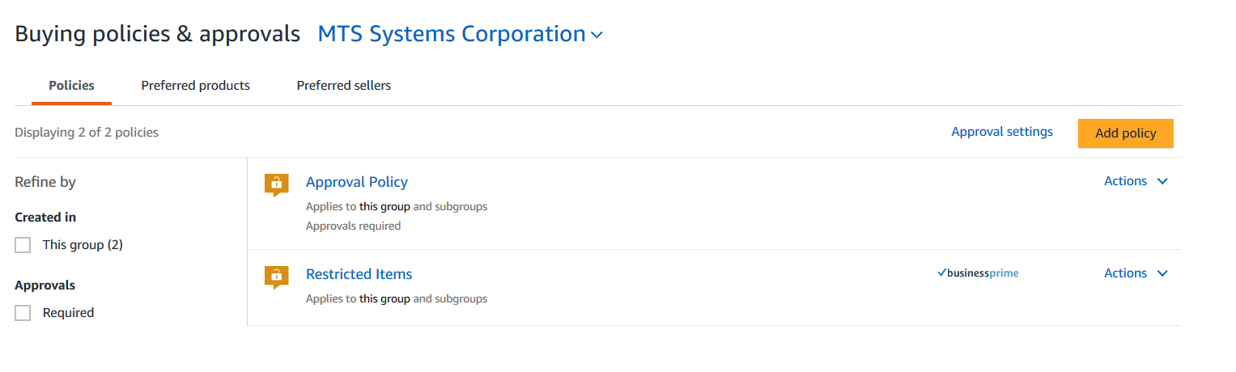
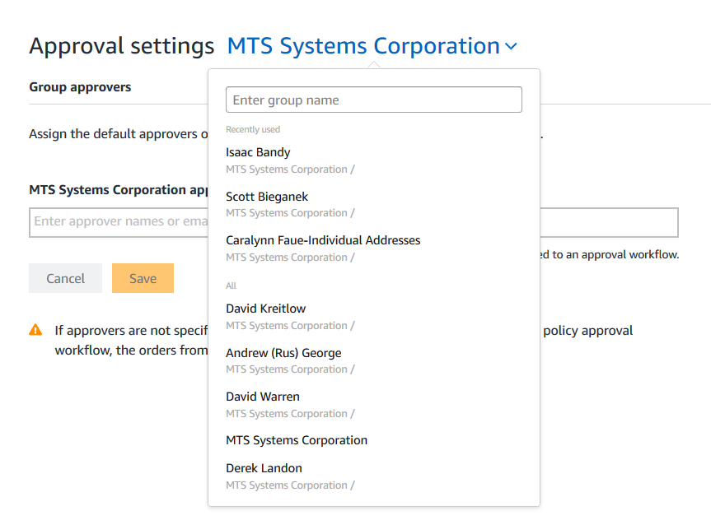
Editing Approval Workflows with ’Group Approver’
To change a group’s existing ‘group approver’ or to add a new group approver, go to Buying policies & approvals (under Business Settings). Then navigate to the group you want to edit using the drop down menu. From that group’s page you can edit that specific group’s ‘group approver’.
Company Name
Group 1
Group 2

Slide 23
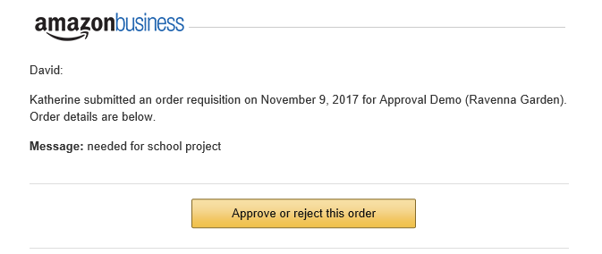
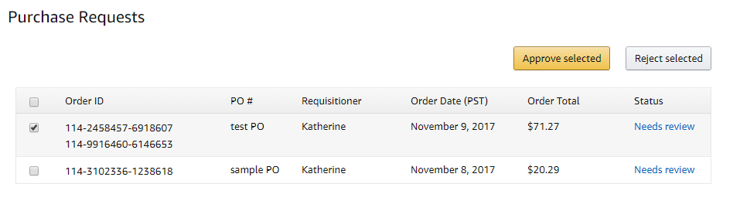
Approving Orders
Any time an order is routed to you for approval, you will get an email notifying you of the request. Purchase requests can be approved directly from the email or by navigating to Approve Orders in the top right drop down of your account.
Once a purchase is submitted for approval, the order is held for 7 days. Approval requests that take longer than 7 days will be rejected
If you have multiple orders awaiting approval, you have the option to approve or reject them in bulk
    Any time you reject an order, you can send comments back to the requisitioner explaining why the order was rejected
    When an order is approved, an order confirmation email is sent to the requisitioner letting them know that their order was approved and is now being processed by Amazon

Slide 24
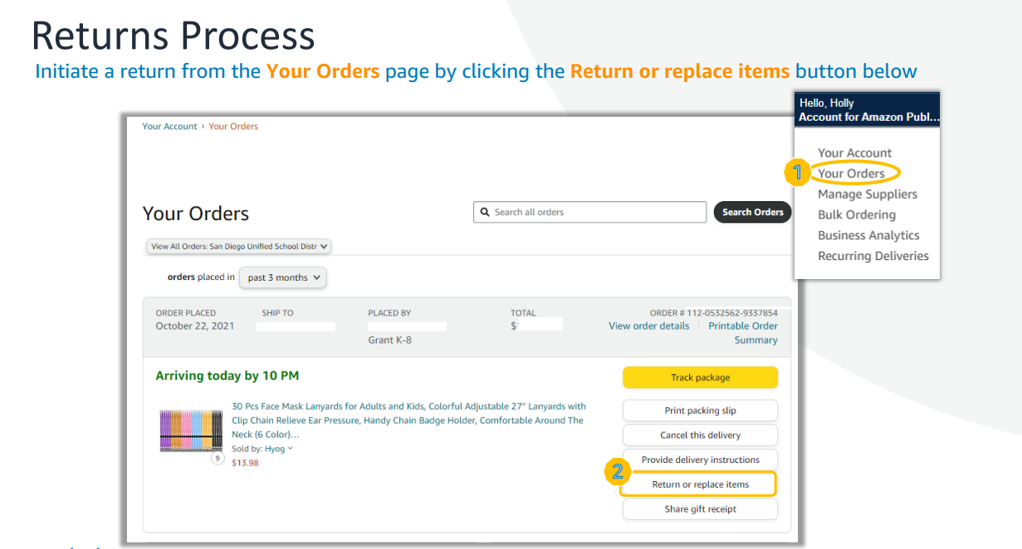

Slide 25
Business Analytics & Spend Visibility

Slide 26
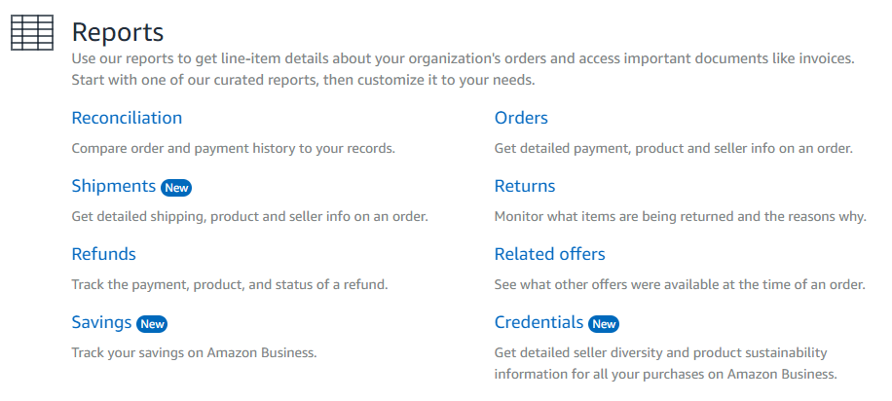
Amazon Business Analytics
Business Analytics offers eight default reporting options to choose from depending on your reporting needs.
Amazon Business Analytics provides the ability to:
Aggregate purchases to compare and track spend over time
Monitor and track 60+ data fields including customer info, shipment info, payment info, and seller info
Customize and save report templates to meet business needs
Download CSV files to analyze your data in excel
Resources:
Download order documentation and invoices from Business Analytics
Amazon Business Analytics Glossary of Terms
Notes:
There are 8 default reports available in Business Analytics
Order Report
Reconciliation Report
Shipments Report
Returns Report
Refund Report
Related Offers Report
Savings Report
Credentials Report
Reports can be used as-is or customized using the Filters and Adjust Columns pane.
In the interest of time, this presentation will focus on the 2 most interesting and ProServ relevant reports and provide a customer use case for each

Slide 27
Your Orders

Slide 28
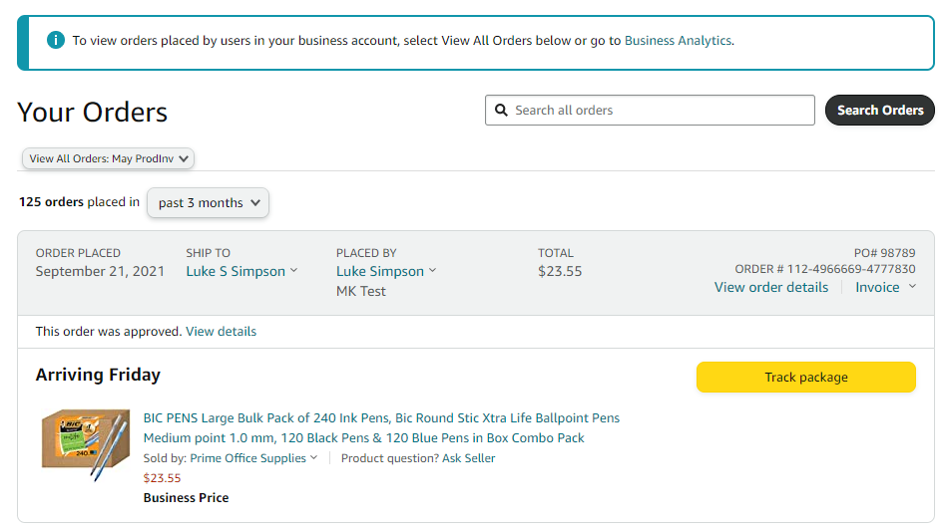
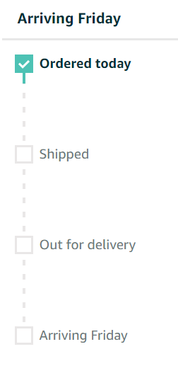
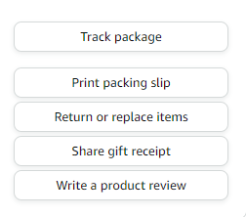

Your Orders
This section of the account provides additional detail regarding the status of all orders that have been placed within the Business Account. You will also use this page to Return of Replace Items on behalf of your buyers
As an Admin ensure you select “view all orders” to see every order in the account

Slide 29
Business Customer Support

Slide 30
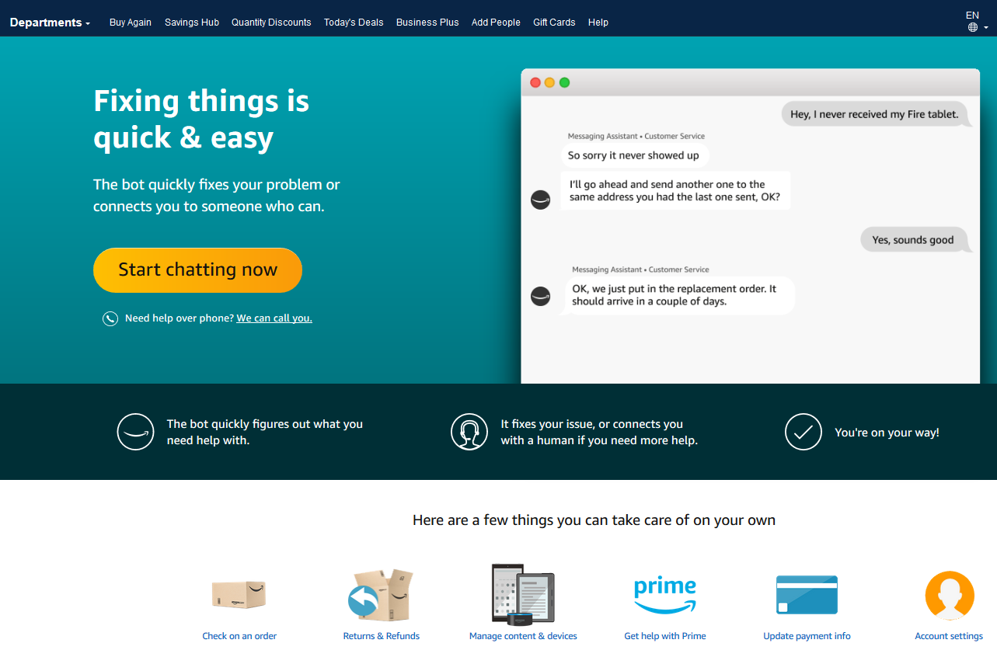

Business Customer Support
Dedicated U.S. based Business Customer Support can be reached a number of ways including email, chat and phone. Not sure what you’re looking for? Learn more about the features and benefits on Amazon Business HERE.
Notes:
Your users should be instructed to reach out to Customer Service for any order, shipping, refund related questions”

Slide 31
Supplemental Documentation

Slide 32
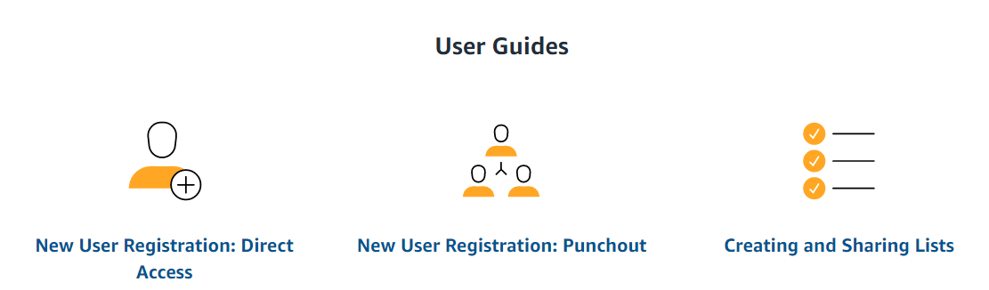
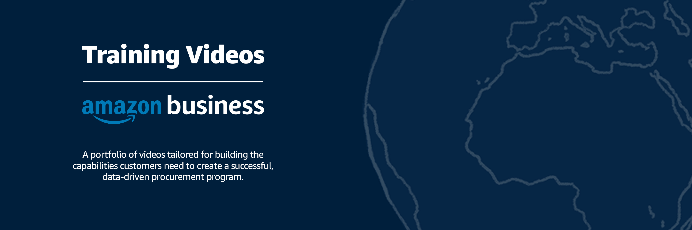
How To Guides and Helpful Videos
Self Service Resources
Training Videos

Slide 33

Common Amazon Business Support Questions
Quick resolutions to frequently asked questions and contact information for a variety of support resources
Contact Business Customer Support: CLICK HERE
  Provides end users the option to call, email, or live chat. Please use this method of contact for anything relating to an order, transaction, charge, or shipment
Cancel an Individual Prime Membership:
  Your Account > Manage My Prime Membership > End Membership
  The end user must follow the steps to receive a pro-rated refund
Request a Tax Exemption Refund:
  Your Orders > Locate Order > Contact Seller > Request refund through email
  Additional tax queries can be emailed to tax-exempt@amazon.com

Slide 34


